Slide 1
Informative website on COVID-19
Dhanvi Mange- 119A3013
Divyalaxmi Thiruganan-119A3015
Madhuri Ramakrishnan- 119A3032
Mahitha Vaidyanathan- 119A3054
Guide:- Mrs. Varsha Patil

Slide 2
Introduction
We have created an informative website on the current situation of COVID-19.
It highlights various aspects related to Coronavirus such as the Symptoms, Precautions, Treatment, Modes of transmission and some general Facts.
It includes interesting features such as The corona virus map which shows the live count of number of cases around the world as well as a symptom checker which enables the user to check the risk of getting infected by the virus.

Slide 3
Project Idea
The idea behind the website is to provide necessary and important information about COVID-19 .
The website helps to create awareness among the people and also tell them the necessary precautions that can be taken to avoid the virus.
The website also provides a collective data of helpline numbers of all the states and union territories of India which can be used by the user in case of emergencies.

Slide 4
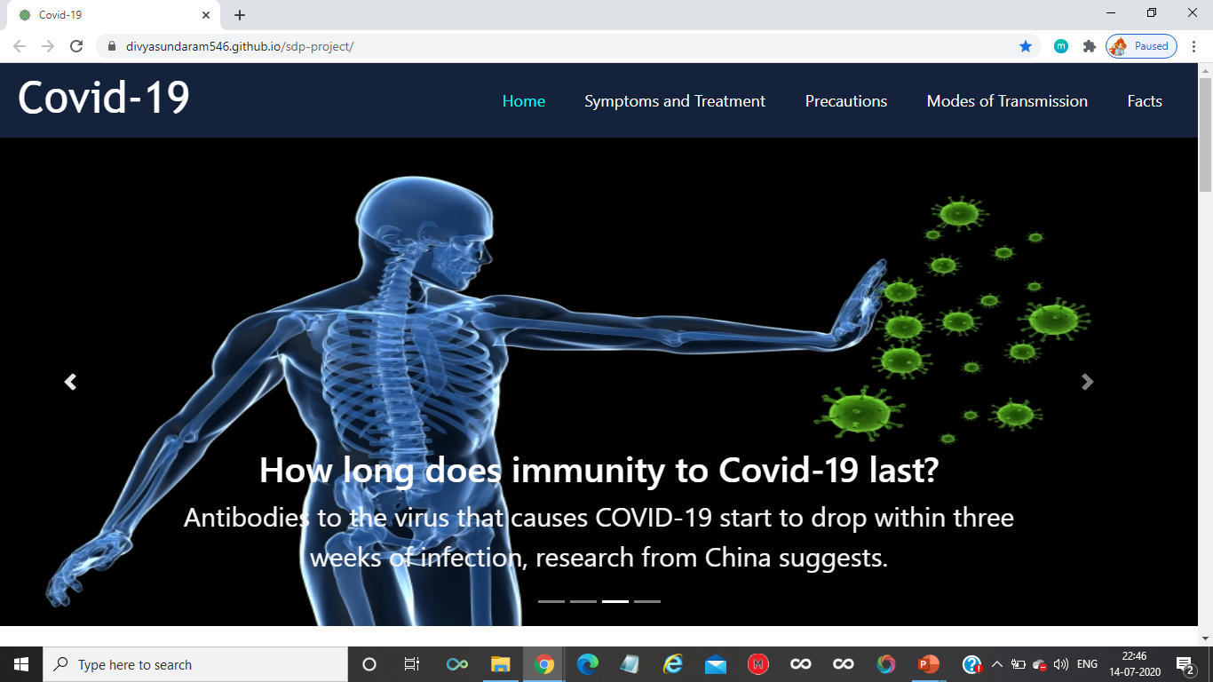
DEMO
https://dhanvi1911.github.io/covid-19-website/pages&images/

Slide 5
Applications
Provides user about the general and effective information which lowers the risk of spread of fake information.
The Coronavirus tracker helps the user to check the statistics of the count of the cases, recoveries and deaths around the world.
The Symptom checker helps the user identify COVID-19 symptoms and their risk profile.

Slide 6
Conclusion
This website will be useful for users to analyze the COVID-19 situation.
Thus we took an initiative and created this website to spread awareness as a social cause.
It answers the ongoing myths about the spread and precautionary measures to be taken during this pandemic situation.

Slide 7
Thank you
Stay Home
Stay Safe

